Slide 1

CHEM 105
Sections 31-49
Time is all the capital stock there is on earth. …If properly used, it brings that which will add to your comfort, convenience, and satisfaction.
-Brigham Young, Discourses
Time is your most valuable and least renewable resource.
The bad news is that time flies. The good news is that you’re the pilot.
– Michael Altshuler
Dr. Stacey J. Smith
Fall 2024
Success is not final; failure is not fatal: it is the courage to continue that counts.
-Winston Churchill
Notes:
Gratefully, even though we are imperfect, we are invited as His guests into His House. He extends this invitation to us again and again, and if we accept it, it will—as promised by President Russell M. Nelson—bless our lives “in ways nothing else can.”
- Allen D. Haynie
BYU Devotional Oct 10, 2023

Slide 2
Lecture 15:
4.7-4.9
Lewis Structures II:
Formal Charge
4.1 Chemical Bonds and Greenhouse Gases
4.2 Electronegativity, Unequal Sharing, & Polar Bonds
4.3 Naming Compounds and Writing Formulas
4.4 Lewis Symbols and Lewis Structures
4.5 Resonance
4.6 The Lengths and Strengths of Covalent Bonds
4.7 Formal Charge: Choosing among Lewis Structures
4.8 Exceptions to the Octet Rule
4.9 Vibrating Bonds and the Greenhouse Effect
5.3 Polar Bonds and Polar Molecules
Notes:
Learning Objectives:
Draw Lewis Dot Structures for simple ionic and molecular compounds
Calculate bond order
Relate bond order, bond strength, and bond length
Draw Resonance structures
Assign formal charges & choose best resonance structures
Understand limitations of Lewis dot structures & exceptions to the octet rule

Slide 3

Lewis recipe
For predicting structure at a glance
NO₂⁻
Count the valence e- present
Predict the connectivity of the atoms
  Central atom = atom that can form the most bonds and/or is the least electronegative atom
  Order of atoms in formula is often indicative
Draw single bonds to connect all atoms
Use remaining e- as lone pairs to complete octets of all atoms
(give e- to most electronegative atoms first)
  If there are not enough e- to go around, convert some lone pairs to bonding pairs
  If there are more e- than needed, put remaining e- on the central atom as lone pairs (if period 3 or below)
Draw resonance structures as necessary
Check that the # of e- in your Lewis structure(s) matches the # in step 1
Check that the # of bonds makes sense
Check Formal Charge to identify the
best structure (if they’re not equivalent)
OCTET RULE: atoms tend to gain, lose, or share e- until they are surrounded by 8 valence e-
Notes:
Yep, that’s my mom! Mrs. Lewis!

Slide 4

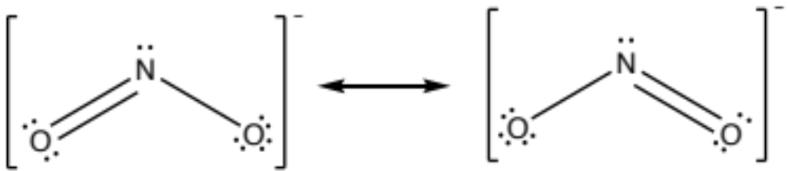
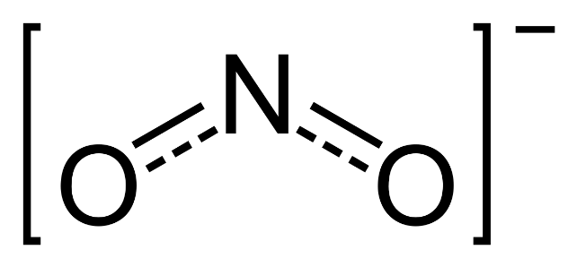
iClicker Quiz
What is the bond order for the N-O bonds in (NO₂⁻)?
1
1.5
1 and 2
2
What is bond order?
REMEMBER:
Resonance is the wrong picture of reality
But it’s really useful for e- bookkeeping
Delocalization is the right picture of reality
Actual molecule = weighted average of the resonance structures
Resonance structures don’t always contribute equally to the delocalization…
Notes:
Be done at 0:10
C
3Mg²⁺ + 2P^{3–} ⟶ Mg₃P₂

Slide 5
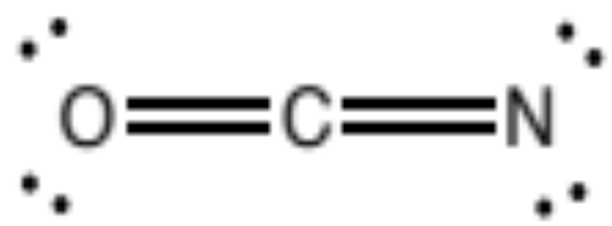
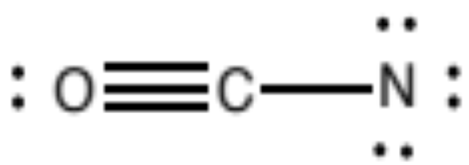
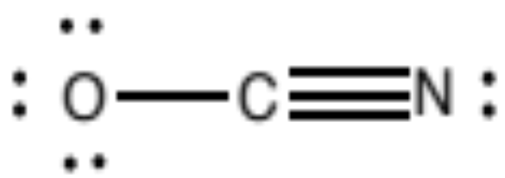
Cyanate
OCN⁻
For example: Draw the Lewis structure for cyanate, OCN⁻ Include any possible resonance structures.
–1
–1
–1
Are these resonance structures equivalent?
NO!
(triple bonds between CN do not have the same bond energy as triple bonds between CO, etc)
So how do we know what the molecule looks like?
Take a weighted average!
How do you know which one(s) to weight more heavily?

Slide 6
Formal Charge
(# valence e–) – (# e– ‘owned’ in structure)
Formal charge on an atom:
(normal # valence e–) – [(# e– in lone pairs) + 1/2 (bonding e–)]
Nonzero formal charge on an atom indicates a deviation from that atom’s typical # of bonds
The best Lewis structure…
  …minimizes formal charge
  …puts negative charge on the most electronegative atom (when charge is unavoidable)
–1
–1
–1
0
0
-1
1
0
-2
-1
0
0
Notes:
The Lewis structure that contributes the most to the average structure of the molecule is the first one in which all formal charges are zero.

Slide 7
iClicker Quiz
Which is the ‘best’ or most heavily weighted resonance form for cyanate ion, OCN–?
A
B
-1 0 0
0 0 -1
C
+1 0 -2
The “best” resonance form (1) minimizes formal charge and
(2) puts any negative charge(s) on the most electronegative atom(s)
Notes:
Start at 0:20
C
3Mg²⁺ + 2P^{3–} ⟶ Mg₃P₂

Slide 8
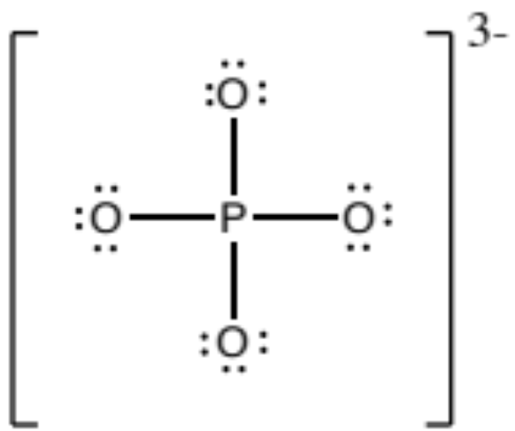
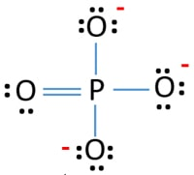
iClicker Quiz
What is the formal charge on the P atom in the Lewis structure of the phosphate ion below?
0
+1
-1
+2
-2
Formal charge on an atom:
(normal # valence e–) – [(# e– in lone pairs) + 1/2 (bonding e–)]
-1
The sum of all formal charges must equal the charge of the molecule!
+1
← How could we improve this Lewis structure?
-1
-1
-1
The “best” resonance form (1) minimizes formal charge and
(2) puts any negative charge(s) on the most electronegative atom(s)
Notes:
Done by 0:25

Slide 9
Rule Breakers
More than an octet → “Expanded octet”
P in phosphate has more than an ‘octet’ of valence electrons!
  “Expanded” valence shell
Atoms in the 3rd period and below can accommodate more than 8 valence e-
  larger size, more + charge in the nucleus
When?
  When it decreases formal charge on the central atom
    Often occurs when a central atom with Z>12 is bonded to strongly electronegative elements (F, O, Cl)
  When there are more than enough electrons to go around
    And the central atom is from period 3 or below
  When the predicted # of bonds is clearly not enough
    Sometimes the # of predicted bonds using the typical formula is not enough to form single bonds to all atoms; must ‘expand the valence shell’
Notes:
Need 40 e-
Have 34 e-
# bonds = 6/2 = 3 bonds? But that’s not even enough to connect all 5 atoms!
Let’s just take the 40 e- and distribute them the best we can

Slide 10
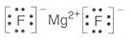
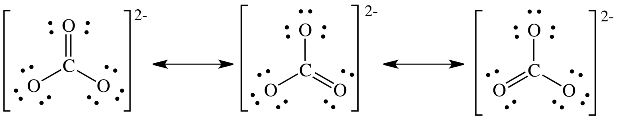
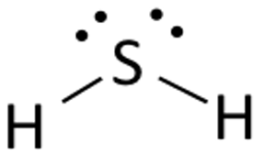
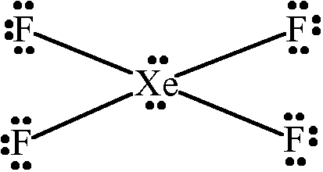
iClicker Quiz
Which of the following contains an atom with an expanded octet?
MgF₂
CO₃²⁻
H₂S
XeF₄
None of them
Notes:
0:30

Slide 11
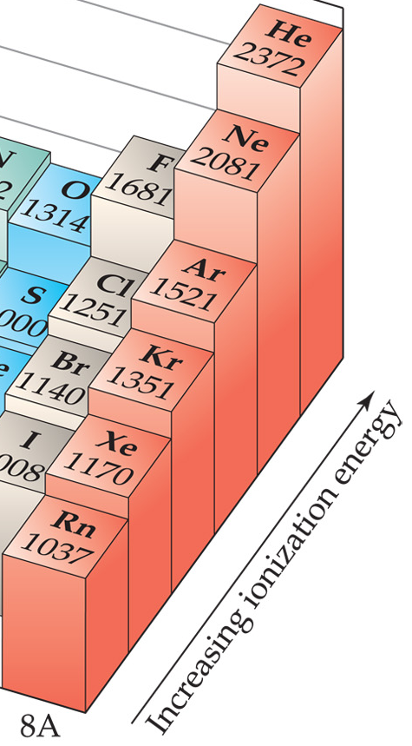
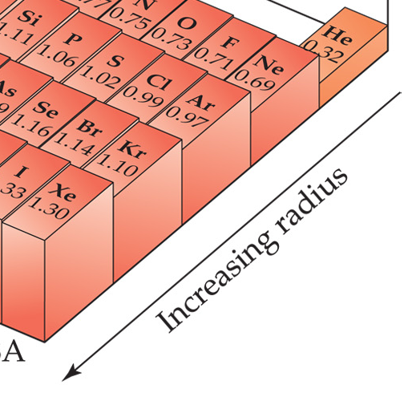
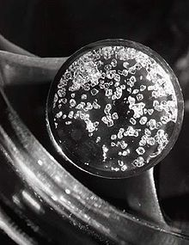
Noble Gases
Unreactive… or are they?
Ionization energy ↓ going down the group as radius ↑
1962 – Neil Bartlett (Canada) formed Xe compounds
Xe → XeF₂, XeF₄, XeF₆
Kr → KrF₂
  only known stable compound
Ar → made HArF in 2000
  only stable at low T
Nobel gas + Halogen
  Excimer Lasers (KrF, XeCl…)
  Use to fabricate microchips & in eye surgery
XeF₄ crystals

Slide 12
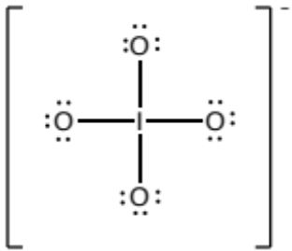
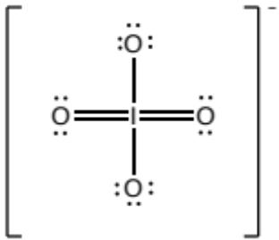
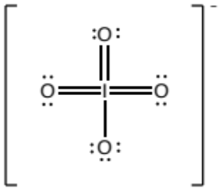
iClicker Quiz
What is the best Lewis Structure for IO₄⁻ , the periodate ion? (contributes the most weight to the delocalized structure)
-1
-1
0
A.
B.
C.
+3
+1
0
0
0
-1
-1
0
0
-1
-1
-1
Look at formal charge
Which one minimizes formal charge?
Which one has unavoidable negative charges on the most electronegative atom?
Notes:
Done by 0:35
3Mg²⁺ + 2P^{3–} ⟶ Mg₃P₂

Slide 13

Octet Rule vs. Formal Charge:
which one is more important?
Period 3 elements and below: minimize formal charge
Period 2 elements and above: minimize formal charge
while following the octet rule
(or having less than an octet…)
(Z < 12)
Notes:
0:35

Slide 14
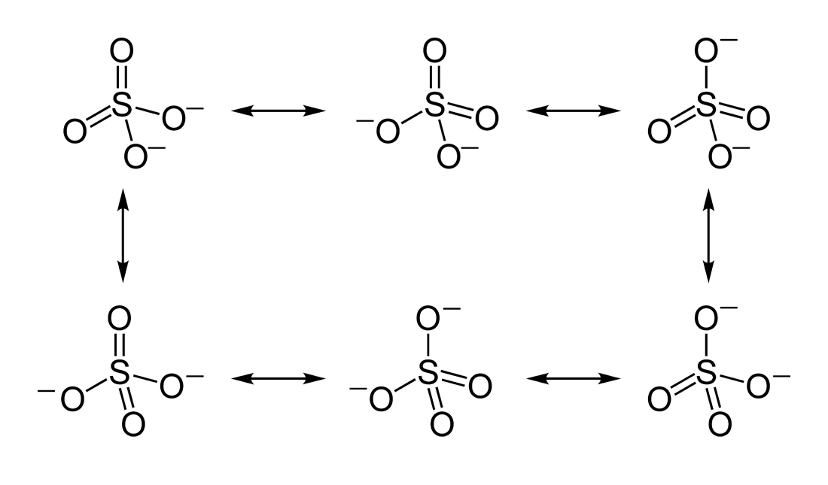
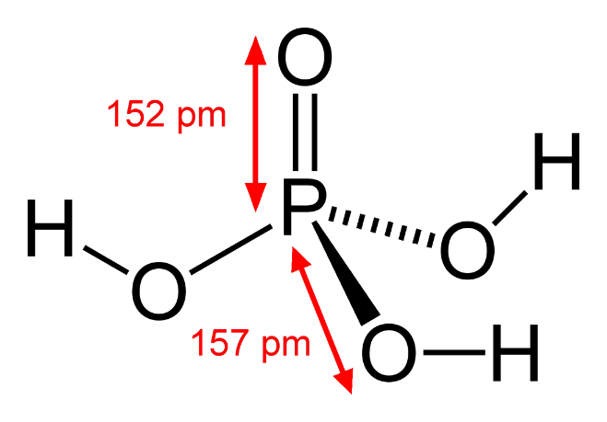
Practice Drawing Lewis Structures:
Expanded Octets
Draw Lewis diagrams of these molecules:
  SO₄ ^{2–}
  H₃PO₄

Slide 15
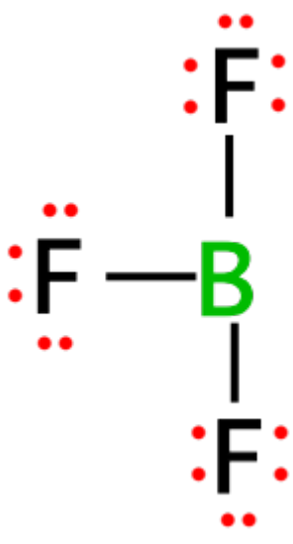

Rule breakers
Less than an octet
Draw the Lewis structure for BF₃
0
+1
•
F
•
•
•
Less than full octets can occur for Be, B, Mg when it minimizes formal charge
These atoms are small & not very electronegative – don’t need 8 valence e- to be stable
••
0
•
F
B
-1
•
••
•
F
•
•
•
••
Notes:
Need 32 e-
Have 24 e-
# bonds = 8/2 = 4 bonds
Resonance structures? What are the formal charges?
A +1 charge on F??? Not likely!
Boron is so much less electronegative than F that the 3 F atoms hog all the e-
Boron doesn’t need 8 to be stable

Slide 16
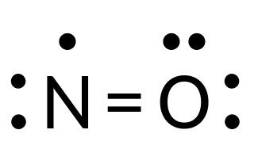
Rule breakers
“Radicals”
Draw the Lewis structure for NO
Structure is reasonable, except for the unpaired e- & lack of octet on N atom
Free Radical:
  Odd-electron molecule with an unpaired e⁻ in its Lewis structure.
  Usually very reactive!
0
0
Notes:
Need 40 e-
Have 34 e-
# bonds = 6/2 = 3 bonds? But that’s not even enough to connect all 5 atoms!
Let’s just take the 40 e- and distribute them the best we can

Slide 17

Octet rule Exceptions
There are many exceptions to the octet ‘rule’
  For elements with Z>12, minimizing formal charge is often more important, and “expanded valence shells” can occur
  For elements with Z<12, minimizing formal charge is important, but these small elements also usually follow the octet rule
  (**unless having less than an octet minimizes formal charge**)
Octet Rule is most useful for period 2 p-block elements → C, N, O, F
Organic Chemistry!
The Octet Rule
Unfortunately, Mother Nature’s never heard of it →

Slide 18

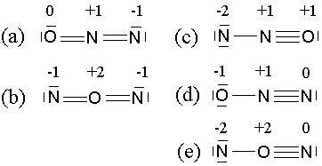
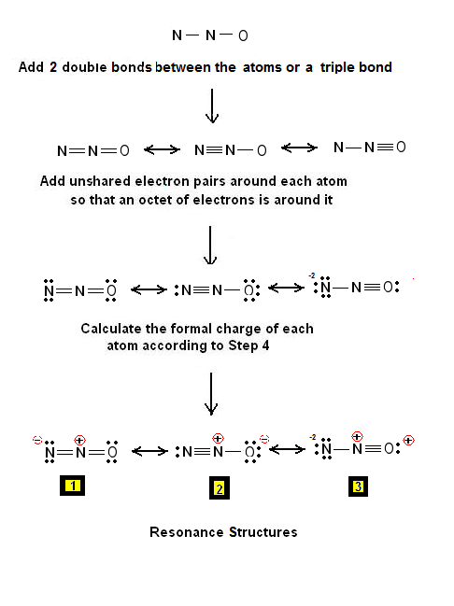
Using Lewis Diagrams to Predict Structure
What is the structure of N₂O (laughing gas)?
Is it NON? Or is it NNO?
NON:
NNO:
Notes:
Start between 0:40 – 0:45

Slide 19
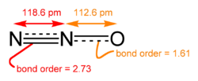
Using Lewis Diagrams to Predict Structure
Which NNO resonance structure(s) do you predict contribute the most weight to the delocalized structure?
The structure containing the N-N triple bond minimizes formal charge and places the -1 formal charge on O, the more electronegative atom.
The 2nd structure is therefore the dominant structure, though the real delocalized molecule is more like a weighted average (#1 + #2 + #3)
What do you predict the N-N and N-O bond orders to be?
  The N-N bond order will be between 2-3
  The N-O bond order will be between 1-2
112.6 pm
118.6 pm

Slide 20
Using Lewis Diagrams to Predict Structure
Octet Rule vs. Formal Charge
Why not form 5 bonds with the central N?
Forming 5 bonds at the central N would decrease formal charge to 0 for all atoms. However, this would result in an expanded octet (10 e- for the central N) which period 2 elements aren’t really big enough to handle; as seen below, the measured bond orders are less than 3 and 2, giving the central N ~8.68 valence e-, not 10. So, in the case of period 2 elements, we minimize formal charge while giving the element an octet (or less) of valence e-
112.6 pm
118.6 pm

